Slide 1
CSE 220
Data Structures
Lecture 02:
Linked List Primer
Anwarul Bashir Shuaib [AWBS]
Lecturer
Department of Computer Science and Engineering
BRAC University

Slide 2




Review: Time and Space Complexity
Big-O is like a "speedometer" for your code.
  It tells you how fast your code runs or how much memory it uses as the input grows.
  It’s Not Exact: Big-O doesn’t count every single step. Instead, it gives you a general idea of how your code scales.
Example:
  If your code takes steps, Big-O simplifies it to
  Why? Because as n gets really big, the part dominates the others

Slide 3
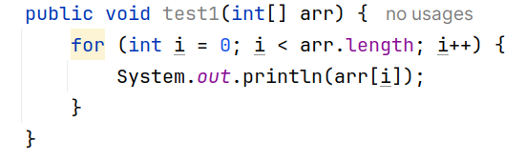
Exercise

Slide 4
Exercise
TC: O(n)
SC: O(1)

Slide 5
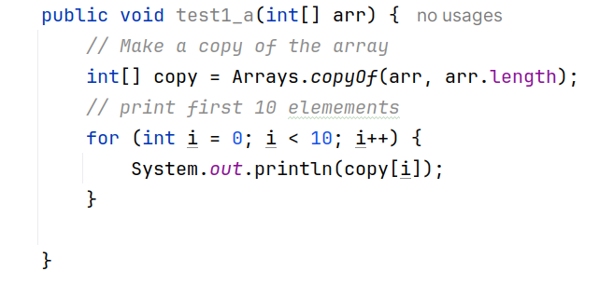
Exercise

Slide 6
Exercise
TC: O(n)
SC: O(n)

Slide 7
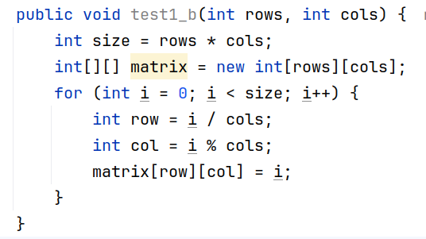
Exercise

Slide 8

Exercise
TC:
SC:

Slide 9
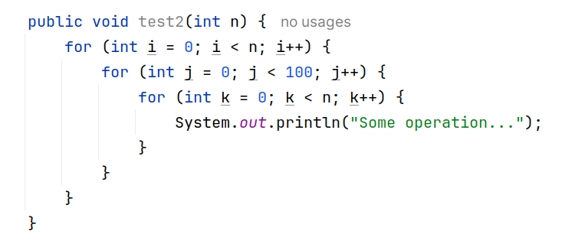
Exercise

Slide 10

Exercise
TC:
SC: O(1)

Slide 11
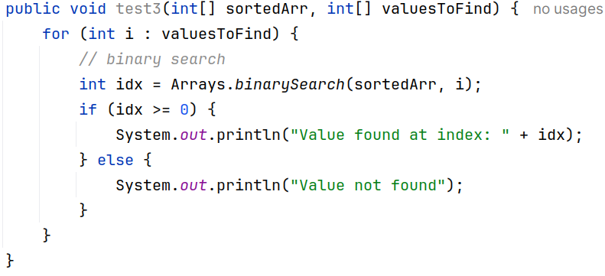
Exercise

Slide 12
Exercise
TC: O(nlogn)
SC: O(1)

Slide 13
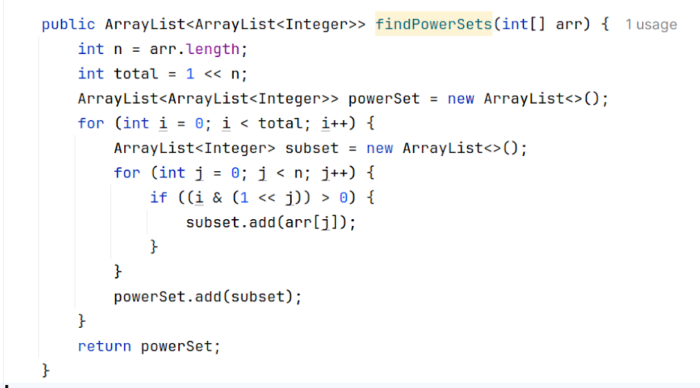
Exercise

Slide 14

Exercise
TC:
SC:

Slide 15
Goal
Design data structures that lets us perform the following tasks in an efficient way:
  Insertion of a new element
  Deletion of an existing element
  Checking if an element exists
  Modification of an existing element
  Finding the minimum / maximum element
There is no “one size fits all” solution!

Slide 16
Arrays vs. Linked Lists
Arrays:
  Fixed size (static).
    Insertion/deletion is expensive (requires shifting elements).
    Random access is fast ⇒ O(1).
Linked Lists:
  Dynamic size (grows/shrinks as needed).
    Insertion/deletion is efficient ( O(1) at head/tail).
    Sequential access (no random access, O(n) for traversal).

Slide 17
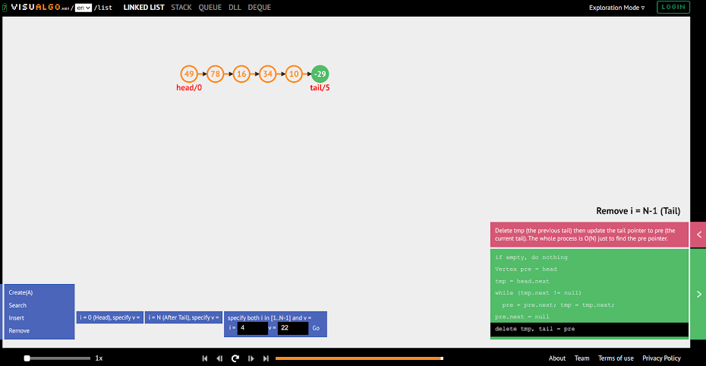
Interactive Visualization
https://visualgo.net/en/list

Slide 18
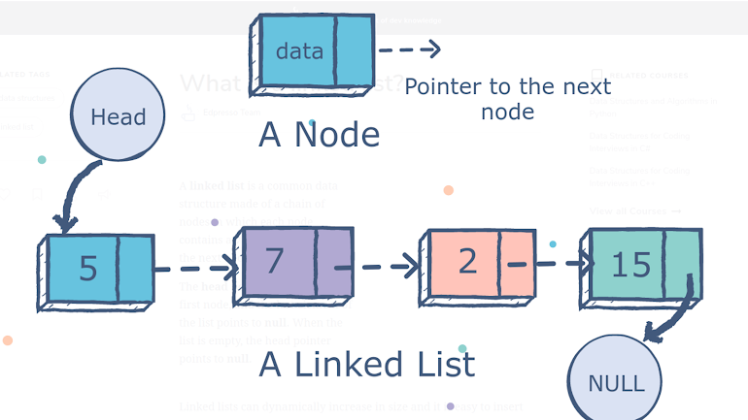

Linked List Overview
A node is the building block for linked lists.
Contains two key things:
Data
Reference to next node
https://dev.to/tastaslim/an-introduction-to-linked-list-1bmp

Slide 19
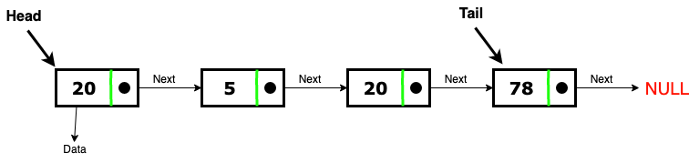
Linked List Overview
The first element is often called “head”
The last element is often called “tail”

Slide 20
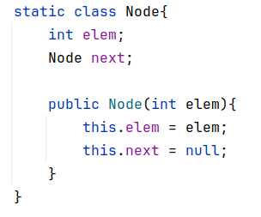

Node
Linked List

Slide 21
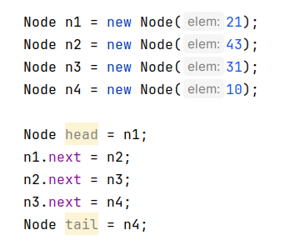
Linked List Creation
Create a linked list from these elements: 21, 43, 31, 10

Slide 22
Linked List Creation
Create a linked list from these elements: 21, 43, 31, 10
21
43
31
10
null
null
null
null

Slide 23
Linked List Creation
Create a linked list from these elements: 21, 43, 31, 10
head
21
43
31
10
null
null
null
null

Slide 24
Linked List Creation
Create a linked list from these elements: 21, 43, 31, 10
head
21
43
31
10
null
null
null

Slide 25
Linked List Creation
Create a linked list from these elements: 21, 43, 31, 10
head
21
43
31
10
null
null

Slide 26
Linked List Creation
Create a linked list from these elements: 21, 43, 31, 10
head
21
43
31
10
null

Slide 27
Linked List Creation
Create a linked list from these elements: 21, 43, 31, 10
head
tail
21
43
31
10
null

Slide 28
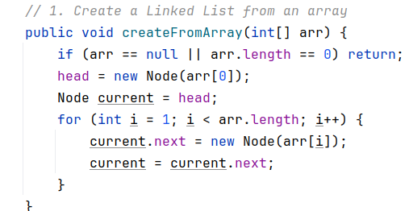

Linked List Creation
Create a linked list from an array arr = [21, 43, 31, 10]

Slide 29

Linked List Creation
Create a linked list from an array arr = [21, 43, 31, 10]

Slide 30
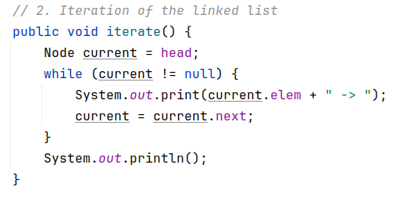
Sequential Traversal
Output: 21->43->31->10->
Think: Why did we need a “current” node?

Slide 31
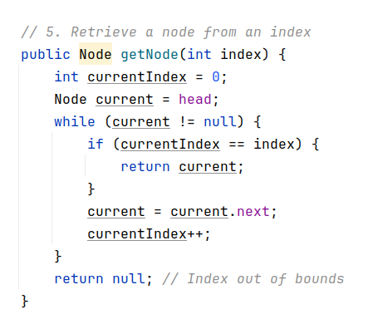
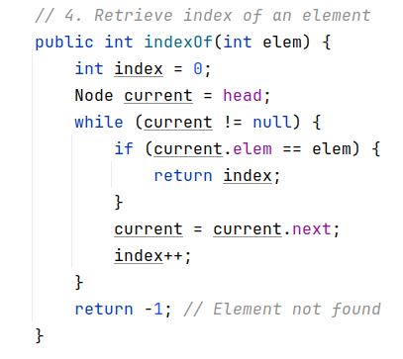
Element Access

Slide 32
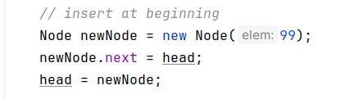
Element Insertion (At the beginning)
Prepend 99 to the list
head
tail
99
21
43
31
10
null
null

Slide 33
Element Insertion (At the beginning)
Prepend 99 to the list
head
tail
99
21
43
31
10
null
null

Slide 34
Element Insertion (At the beginning)
Prepend 99 to the list
head
tail
99
21
43
31
10
null

Slide 35

Element Insertion (At the beginning)
Prepend 99 to the list
head
tail
99
21
43
31
10
null

Slide 36
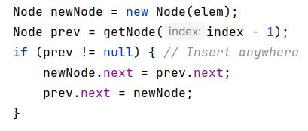
Element Insertion (any position)
100
Insert here
Insert 100 at position 2
head
tail
99
21
43
31
10
null
head
tail
99
21
100
43
31
10
null

Slide 37
Element Insertion (any position)
Insert 100 at position 2
head
tail
99
21
43
31
10
null

Slide 38
Element Insertion (any position)
100
null
Insert 100 at position 2
head
tail
99
21
43
31
10
null

Slide 39
Element Insertion (any position)
100
null
Insert 100 at position 2
head
tail
99
21
43
31
10
null

Slide 40
Element Insertion (any position)
100
Insert 100 at position 2
head
tail
99
21
43
31
10
null

Slide 41
Element Insertion (any position)
100
Insert 100 at position 2
head
tail
99
21
43
31
10
null

Slide 42
Element Insertion (any position)
100
Insert 100 at position 2
head
tail
99
21
43
31
10
null
head
tail
99
21
100
43
31
10
null

Slide 43
Element Insertion (any position)
100
Insert 100 at position 2
head
tail
99
21
43
31
10
null
head
tail
99
21
100
43
31
10
null

Slide 44
Element Insertion (any position)
100
Insert 100 at position 2
head
tail
99
21
43
31
10
null
head
tail
99
21
100
43
31
10
null
Ordering is important!

Slide 45

Element Insertion (any position)
100
Insert 100 at position 2
head
tail
99
21
43
31
10
null
head
tail
99
21
100
43
31
10
null

Slide 46

Optimizing Tail Insertion
Append 200 (Insert at the end)
head
tail
99
21
100
43
31
10
null
head
tail
99
21
100
43
31
10
42
null

Slide 47
Optimizing Tail Insertion
200
null
Append 200 (Insert at the end)
head
tail
99
21
100
43
31
10
null
head
tail
99
21
100
43
31
10
42
null

Slide 48
Optimizing Tail Insertion
200
null
Append 42 (Insert at the end)
head
tail
99
21
100
43
31
10
head
tail
99
21
100
43
31
10
42
null

Slide 49
Optimizing Tail Insertion
tail
200
null
Append 42 (Insert at the end)
head
99
21
100
43
31
10
head
tail
99
21
100
43
31
10
42
null

Slide 50
Optimizing Tail Insertion
tail
200
null
Append 42 (Insert at the end)
head
99
21
100
43
31
10
head
tail
99
21
100
43
31
10
42
null

Slide 51
When to Use Linked Lists?
Use linked lists:
  When you need frequent insertions/deletions (e.g., implementing a queue or stack).
  When the size of the data is unknown or changes frequently.
Do not use linked lists:
  Random access is needed (Arrays ⇒ O(1), Linked lists ⇒ O(n)
Practical usage:
  In xv6, the freelist refers to a linked list of free memory pages
  Each free page contains a pointer to the next free page.

Slide 52
Exercise
Remove head
Remove tail
Remove from anywhere
Update element value at index n

